Slide 1
Morning Assembly
By:- Praveer Sharma

Slide 2

MORNING PRAYER

Slide 3

INTERNATIONAL NEWS
 |  |  | SPORTS NEWS
 | NATIONAL NEWS
 |  |  |  |  | CAMPUS NEWS
NEWS

Slide 4
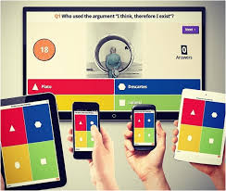
QUIZ

Slide 5

 |  |  |  | ‘विद्या ददाति विनयं’ | ‘Knowledge gives humility’
Sanskrit Shlok

Slide 6
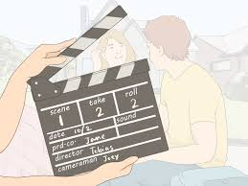
SKIT

Slide 7

SPEECH

Slide 8
TEACHER’S TALK

Slide 9
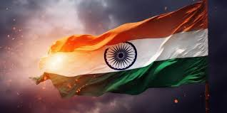
NATIONAL ANTHEM

